Slide 1
Database Management Class Project
Wilson Rey, Ben Weeks

Slide 2
Description
Our “Retail Management System” is designed to help an owner of a retail business keep track of their business’s customers, employees, vendors.
The system allows employees to determine which items are selling the best, how often customers shop, and know what inventory is available across all locations.

Slide 3
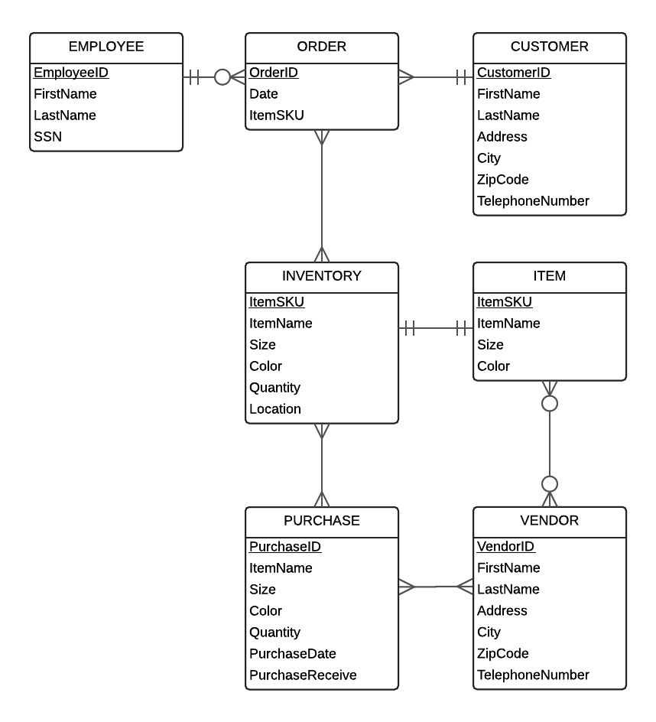
ERD Diagram

Slide 4
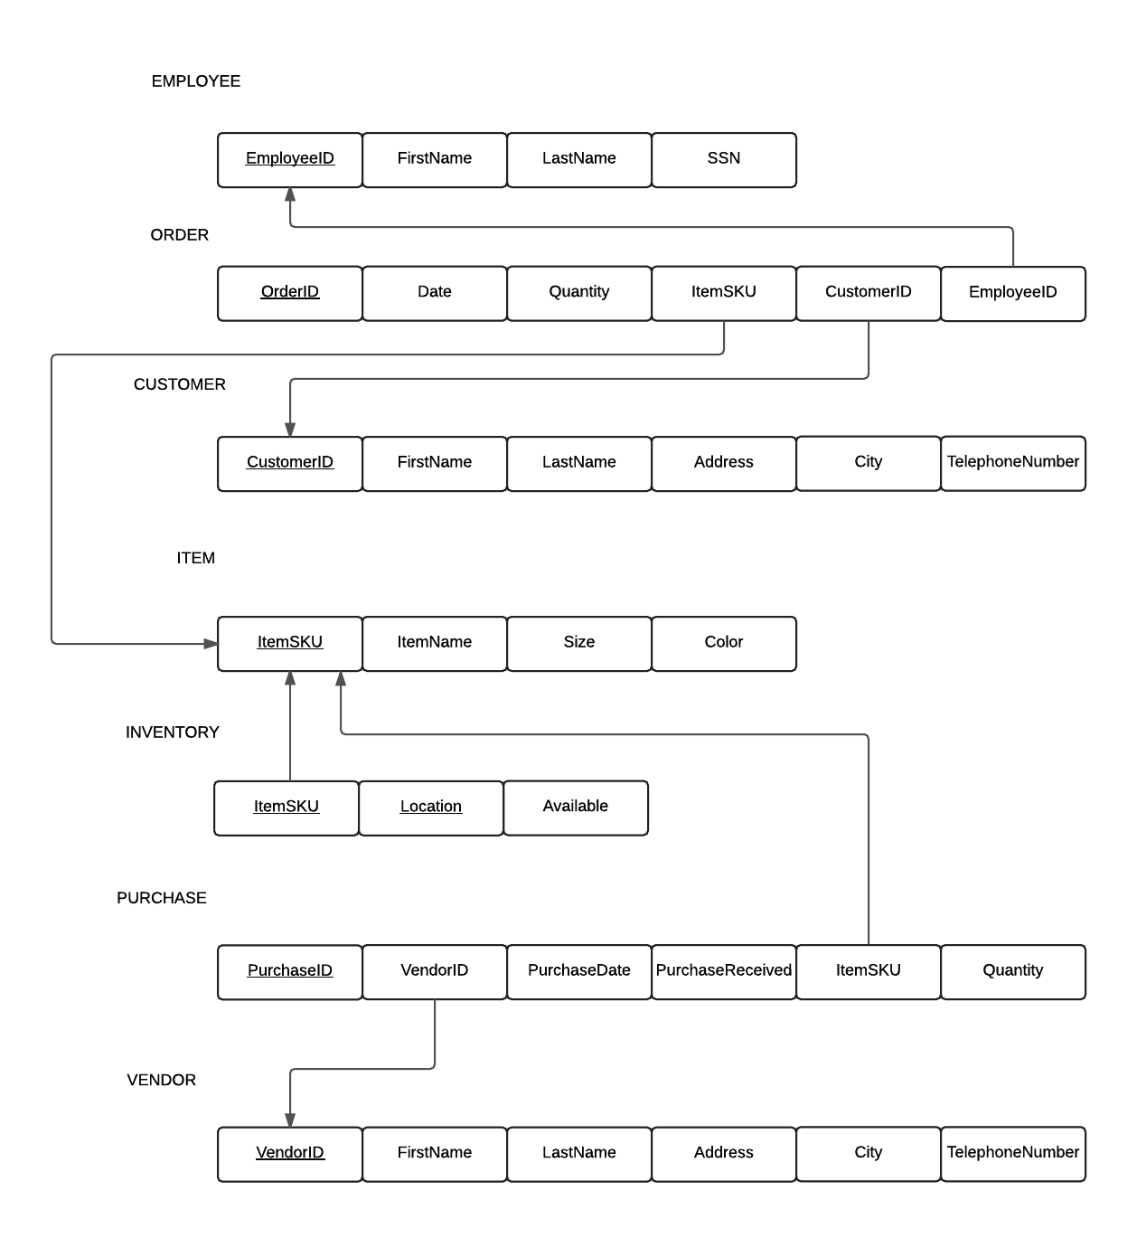
Logical Design

Slide 5
SQL Scripts/Physical Design
CREATE TABLE "EMPLOYEE" (
"EmployeeID" number primary key,
"FirstName" varchar2(25),
"LastName" varchar2(25),
"SSN" varchar2(11));
CREATE TABLE "CUSTOMER" (
"CustomerID" varchar2(6) primary key,
"FirstName" varchar2(25),
"LastName" varchar2(25),
"Address" varchar2(40),
"City" varchar2(25),
"ZipCode" varchar2(9),
"TelephoneNumber" varchar2(13));
In hindsight, CamelCase on columns was a bad idea.
Not a show stopper, just made queries picky about being explicit in “double quotes”.
Order of creating tables was important, can’t make references if the originating table does not exist.

Slide 6
Challenges
Importing the data into the Database.
Some fields were too small.

